Slide 1
Docker 101
Michael Simons (msimons)
Notes:
BIO
Working with Docker for almost 1 ½ years
Driving Docker story for the .NET Core product
.NET Core team relies on Docker heavily within engineering infrastructure
How many people have heard of Docker?
How many people have used Docker?

Slide 2
Agenda
What Problem is Docker Solving
What is Docker
Demo
Q & A

Slide 3
Market View: Evolution of IT
1995
2015
Thin app on mobile, tablet
Thick, client-server app on thick client
Well-defined stack:
- O/S
- Runtime
- Middleware
Assembled by developers using best available services
Running on any available set of physical resources
(public/private/
virtualized)
Monolithic
Physical
Infrastructure

Slide 4
Challenges
2015
Thin app on mobile, tablet
Assembled by developers using best available services
How to ensure services interact consistently, avoid dependency hell
How to avoid n X n different configs
Running on any available set of physical resources
(public/private/
virtualized)
How to migrate & scale quickly, ensure compatibility

Slide 5
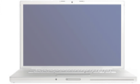
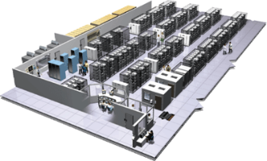
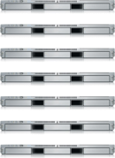
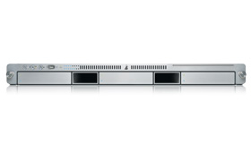
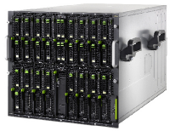
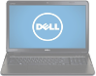
The Challenge
User DB
Static website
postgresql + pgv8 + v8
Queue
Analytics DB
nginx 1.5 + modsecurity + openssl + bootstrap 2
Do services and apps interact appropriately?
Redis + redis-sentinel
hadoop + hive + thrift + OpenJDK
Multiplicity of Stacks
Background workers
Web frontend
Python 3.0 + celery + pyredis + libcurl + ffmpeg + libopencv + nodejs + phantomjs
Ruby + Rails + sass + Unicorn
API endpoint
Python 2.7 + Flask + pyredis + celery + psycopg + postgresql-client
Production Cluster
Development VM
Public Cloud
Multiplicity of hardware environments
Can I migrate smoothly and quickly?
QA server
Disaster recovery
Customer Data Center
Contributor’s laptop
Production Servers

Slide 6
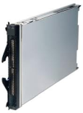
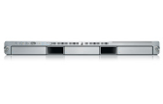
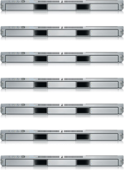

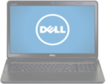
Results in N X N compatibility nightmare
? | ? | ? | ? | ? | ? | ?
? | ? | ? | ? | ? | ? | ?
? | ? | ? | ? | ? | ? | ?
? | ? | ? | ? | ? | ? | ?
? | ? | ? | ? | ? | ? | ?
? | ? | ? | ? | ? | ? | ?
Static website
Web frontend
Background workers
User DB
Analytics DB
Queue
 | Development VM | QA Server | Single Prod Server | Onsite Cluster | Public Cloud | Contributor’s laptop | Customer Servers

Slide 7
A useful analogy…

Slide 8
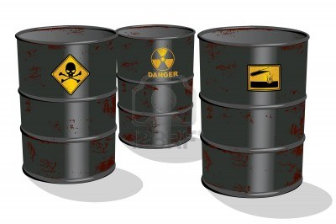
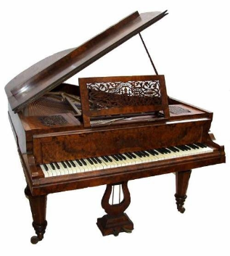

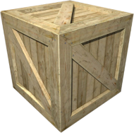
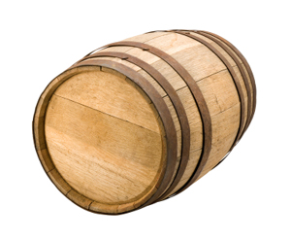
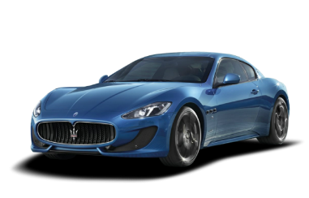
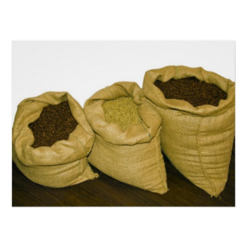
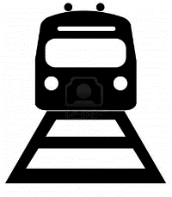
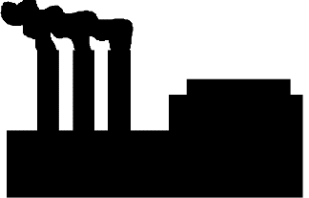

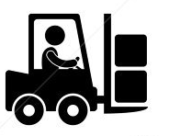
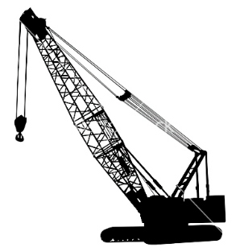
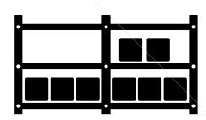

Cargo Transportation Pre-1960
Do I worry about how goods interact (e.g. coffee beans next to spices)
Multiplicity of Goods
Can I transport quickly and smoothly
(e.g. from boat to train to truck)
Multiplicity of methods for transporting/storing

Slide 9
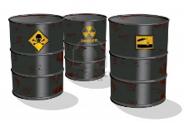

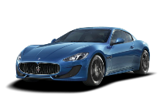


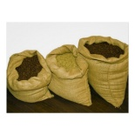


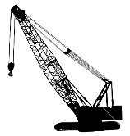



NxN Matrix
 | ? | ? | ? | ? | ? | ? | ?
 | ? | ? | ? | ? | ? | ? | ?
 | ? | ? | ? | ? | ? | ? | ?
 | ? | ? | ? | ? | ? | ? | ?
 | ? | ? | ? | ? | ? | ? | ?
 | ? | ? | ? | ? | ? | ? | ?

Slide 10

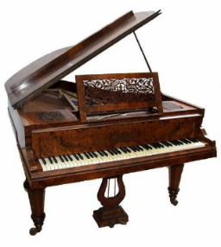

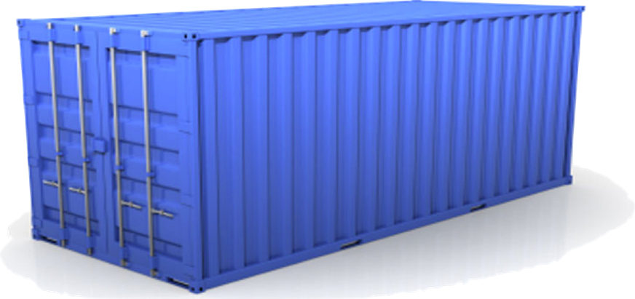
Solution: Intermodal Shipping Container
Do I worry about how goods interact (e.g. coffee beans next to spices)
Multiplicity of Goods
A standard container that is loaded with virtually any goods, and stays sealed until it reaches final delivery.
…in between, can be loaded and unloaded, stacked, transported efficiently over long distances, and transferred from one mode of transport to another
Can I transport quickly and smoothly
(e.g. from boat to train to truck)
Multiplicity of methods for transporting/storing

Slide 11


This eliminated the NXN problem…

Slide 12
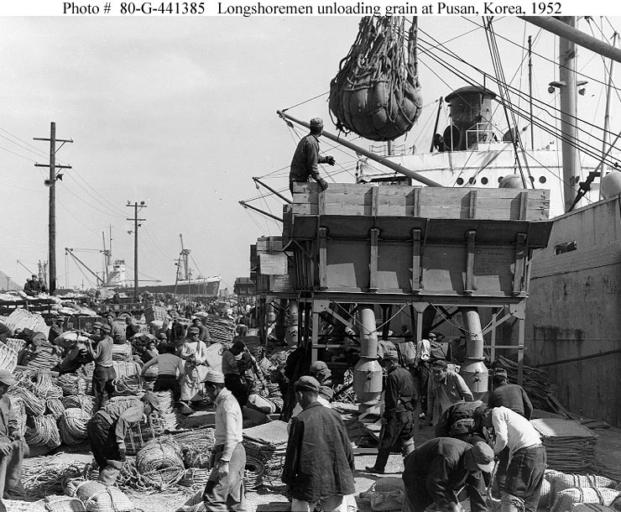
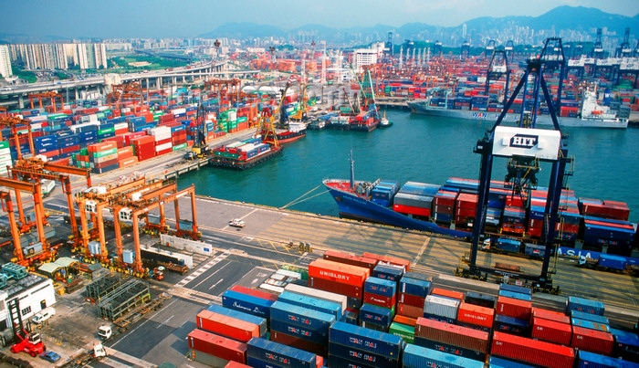
and spawned an Intermodal Shipping Container Ecosystem
90% of all cargo now shipped in a standard container
Order of magnitude reduction in cost and time to load and unload ships
Massive reduction in losses due to theft or damage
Huge reduction in freight cost as percent of final goods (from >25% to <3%)
massive globalizations
5000 ships deliver 200M containers per year

Slide 13
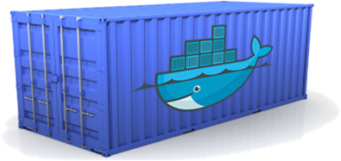
Docker is a shipping container system for code
Static website
User DB
Web frontend
Queue
Analytics DB
Do services and apps interact appropriately?
Multiplicity of Stacks
An engine that enables any payload to be encapsulated as a lightweight, portable, self-sufficient container…
…that can be manipulated using standard operations and run consistently on virtually any hardware platform
Multiplicity of hardware environments
Can I migrate smoothly and quickly
Development VM
QA server
Customer Data Center
Public Cloud
Production Cluster
Contributor’s laptop

Slide 14
Or…put more simply
Static website
User DB
Web frontend
Queue
Analytics DB
Do services and apps interact appropriately?
Multiplicity of Stacks
Developer: Build Once, Run Anywhere (Finally)
Operator: Configure Once, Run Anything
Multiplicity of hardware environments
Can I migrate smoothly and quickly
Development VM
QA server
Customer Data Center
Public Cloud
Production Cluster
Contributor’s laptop

Slide 15
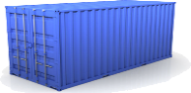
Docker solves the NXN problem
Static website
Web frontend
Background workers
User DB
Analytics DB
Queue
 | Development VM | QA Server | Single Prod Server | Onsite Cluster | Public Cloud | Contributor’s laptop | Customer Servers

Slide 16
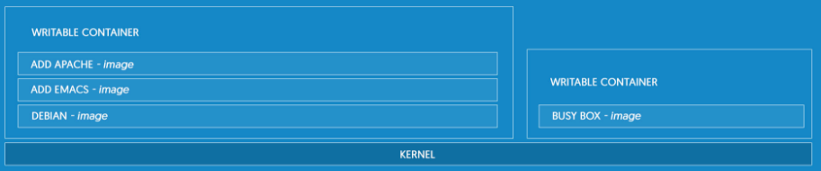
What is docker
Docker is the world's leading software containerization platform
Notes:
Docker is the world's leading software containerization platform
Docker containers wrap a piece of software in a complete filesystem that contains everything needed to run: code, runtime, system tools, system libraries – anything that can be installed on a server. This guarantees that the software will always run the same, regardless of its environment.
LIGHTWEIGHT
Containers running on a single machine share the same operating system kernel; they start instantly and use less RAM. Images are constructed from layered filesystems and share common files, making disk usage and image downloads much more efficient.
OPEN
Docker containers are based on open standards, enabling containers to run on all major Linux distributions and on Microsoft Windows -- and on top of any infrastructure.
SECURE BY DEFAULT
Containers isolate applications from one another and the underlying infrastructure, while providing an added layer of protection for the application.

Slide 17
CONTAINERS VS VIRTUAL MACHINES
Notes:
Containers and virtual machines have similar resource isolation and allocation benefits -- but a different architectural approach allows containers to be more portable and efficient.
VIRTUAL MACHINES
Virtual machines include the application, the necessary binaries and libraries, and an entire guest operating system -- all of which can amount to tens of GBs.
CONTAINERS
Containers include the application and all of its dependencies --but share the kernel with other containers, running as isolated processes in user space on the host operating system. Docker containers are not tied to any specific infrastructure: they run on any computer, on any infrastructure, and in any cloud.

Slide 18
BUILD BETTER SOFTWARE
Skip the setup and maintenance of development environments and language-specific tooling. Focus on creating new features, fixing issues, and shipping software.
Notes:
ACCELERATE DEVELOPERS
Stop wasting hours setting up developer environments, spinning up new instances, and making copies of production code to run locally. With Docker, you simply take copies of your live environment and run them on any new endpoint running a Docker engine.
EMPOWER CREATIVITY
The isolation capabilities of Docker containers free developers from constraints: they can use the best language and tools for their application services without worrying about causing internal tooling conflicts.
ELIMINATE ENVIRONMENT INCONSISTENCIES
Packaging an application in a container with its configs and dependencies guarantees that the application will always work as designed in any environment: locally, on another machine, in test or production. No more worries about having to install the same configurations into different environments.

Slide 19
SHARE AND COLLABORATE
Docker creates a common framework for developers and sysadmins to work together on distributed applications
Notes:
DISTRIBUTE & SHARE CONTENT
Store, distribute, and manage Docker images in Docker Hub with your team. Image updates, changes, and history are automatically shared across your organization.
SIMPLY SHARE YOUR APPLICATION WITH OTHERS
Ship containers without worrying about environment dependencies creating issues for your application. Other teams can easily link to or test against your app without having to learn about how it works.

Slide 20
SHIP SOFTWARE FASTER AND AT SCALE
Docker allows you to dynamically change your application -- from adding new capabilities and scaling services, to quickly changing problem areas.
Notes:
SHIP 7X MORE
On average, Docker users ship 7X more software after deploying Docker in their environment. More frequent software updates provide added value to customers.
QUICKLY SCALE
Docker containers spin up and down in seconds, making it easy to scale application services to satisfy peak customer demand, and then reduce running containers when demand ebbs.
EASILY REMEDIATE ISSUES
Docker makes it easy to identify issues, isolate the problem container, quickly roll back to make the necessary changes, and then push the updated container into production. Isolation between containers makes these changes less disruptive than in traditional software models.

Slide 21
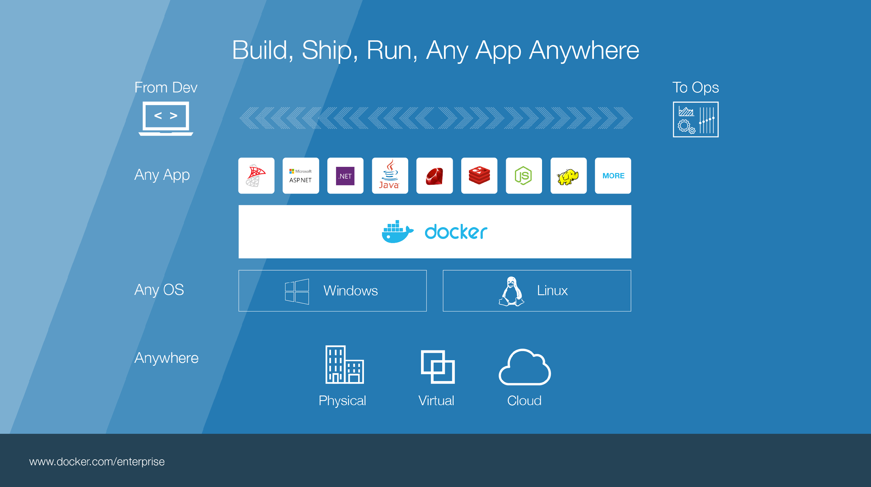
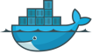
Notes:
Build, Ship, Run – Any App Anywhere – that’s Docker’s slogan
But, what does it mean?
What it essentially boils down to is that developers can choose whatever language or components they want to build their application – .Net, ASP, Java, Ruby, Redis, etc across both the Linux and Windows ecosystem. They are assured that whatever the code up, will run wherever the Ops team chooses to deploy it – Physical, virtual, or cloud – it makes no difference to Docker.
An application written on a developers laptop will run exactly the same on the largest bare metal servers, in the cloud, even on a Raspberry Pi in my den.
Move applications seamlessly from dev to test to production.

Slide 22
Docker Concepts

Slide 23
Image vs Container
Image – it is a template (application plus required binaries and libraries)
Container – a running instance of an image.
Notes:
Class vs instance analogy

Slide 24
Docker Daemon
Builds images
Runs and manages containers
RESTful API

Slide 25
Docker CLI
pull - Pull an image or a repository from a registry
images - List images
run - Run a command in a new container
ps - List containers
rm - Remove one or more containers
rmi - Remove one or more images
Notes:
Command Line Interface

Slide 26
Demo
Notes:
Docker pull Microsoft/sample-dotnet
Docker images
Docker run Microsoft/sample-dotnet
Docker ps
Docker rm
Docker run –rm Microsoft/sample-dotnet

Slide 27
Docker File System
Logical file system by grouping different file system primitives into branches (directories, file systems, subvolumes, snapshots)
Each branch represents a layer in a Docker image
Allows images to be constructed / deconstructed as needed vs. a huge monolithic image (ala traditional virtual machines)
When a container is started a writeable layer is added to the “top” of the file system

Slide 28
Copy on Write
Super efficient:
Sub second instantiation times for containers
New container can take <1 Mb of space
Containers appears to be a copy of the original image
But, it is really just a link to the original shared image
If someone writes a change to the file system, a copy of the affected file/directory is “copied up”

Slide 29
Changes and Updates
Docker
Image Registry
App
A
Push
App Δ
Bins/
Libs
Bins/
Base
Image
Image Mod A’
Image Mod A’’
App Δ
Update
App
A
Bins/
App
A’’
Bins/
Libs
Bins/
Libs
Bins/
Docker Engine
Docker Engine
Host is now running A’’
Host running A wants to upgrade to A’’. Requests update. Gets only diffs

Slide 30
Demo
Notes:
https://microbadger.com/images/microsoft/dotnet-nightly

Slide 31
Dockerfile
Docker can build images automatically by reading the instructions from a Dockerfile. A Dockerfile is a text document that contains all the commands a user could call on the command line to assemble an image.
Notes:
Using docker build users can create an automated build that executes several command-line instructions in succession.

Slide 32
Demo
Notes:
Simple dev Dockerfile to build and run application
Simple deployment application

Slide 33
What about data persistence?
Volumes allow you to specify a directory in the container that exists outside of the docker file system structure
Can be used to share (and persist) data between containers
Directory persists after the container is deleted
Unless you explicitly delete it
Can be created in a Dockerfile or via CLI

Slide 34
Demo

Slide 35
Docker Hub / Docker Store
Implementations of a Docker Registry
Storage for your images
Free for public images
Cost for private images
Provides services
Automated build infrastructure (linked to SCC; triggered by commits)
Security analysis
Automated Deployment
Notes:
Docker Hub is the old
Docker Store is the new
Still in transition
Docker Store cost $
Monitizing compute

Slide 36
Demo

Slide 37
Docker Compose
Compose is a tool for defining and running multi-container applications with Docker. With Compose, you define a multi-container application in a single file, then spin your application up in a single command which does everything that needs to be done to get it running.

Slide 38
Demo
Notes:
Simple demo to store configuration
Cats vs dogs demo

Slide 39
Visual Studio Docker Tools

Slide 40
Demos

Slide 41
Q & A

Slide 42
TODO
Talk about linux vs Windows – images are not exchangeable
Talk about no UI – execution environment
Docker growth

Slide 43
What are the basics of the Docker system?
Image A
Docker
Image Registry
Push
Search
Pull
Source Code Repository
Run
Build
Dockerfile
For
A
Container A
Container B
Container C
Docker
Docker Engine
Host 2 OS 2
Host 1 OS 1

Slide 44
Containers vs. VMs
App
A
App
A’
App
B
Containers are isolated,
but share OS and, where
appropriate, bins/libraries
Bins/
Libs
Bins/
Libs
Bins/
Libs
VM
Guest
OS
Guest
OS
Guest
OS
Guest
OS
Guest
OS
App A
App A’
App B
App B’
App B’
App B’
Container
Docker
Hypervisor
Bins/Libs
Bins/Libs
Host OS
Host OS
Server
Server

Slide 45
Why are Docker containers lightweight?
VMs
Containers
App
A
App
A
App
A’
App
A
App
A
App Δ
Bins/
Libs
Bins/
Libs
Bins/
Libs
Bins/
Libs
Bins/
Guest
OS
Guest
OS
Guest
OS
Guest
OS
Original App
(No OS to take
up space, resources,
or require restart)
Copy of
App
No OS. Can
Share bins/libs
Modified App
Union file system allows
us to only save the diffs
Between container A and container
A’
VMs
Every app, every copy of an
app, and every slight modification
of the app requires a new virtual server

